Slide 1
COMP4960 – Software Engineering
Final Report
Campus Lost and Found Portal
Team 2: Aliyan, Bjordi, Craig, Sammy
Date: 12/04/2025
Notes:
Everyone introduce themselves (say your name)

Slide 2
Contents
Contents........................................................................2
Project Overview................................................................3
Live Demonstration..............................................................4
What Was Completed..............................................................5
What Was Not Completed..........................................................6
Which Requirements Are Not Implemented..........................................7
Problems Encountered............................................................8
Future Work.....................................................................9
Q&A............................................................................10

Slide 3
Project Overview
Our project is a Lost and Found portal for the Wentworth campus.
Students and staff who have lost or found personal items around the university can file a report using either the iOS app or our web app.
Item reports may include:
Item description and image
Last known location (building name and/or a map pin)
Reporter’s name and contact information
Notes:
Sammy

Slide 4
Live Demonstration
Notes:
Bjordi (web) and Craig (iOS)

Slide 5
What Was Completed
Microsoft Authentication fully implemented on both iOS and Web using Firebase Auth.
Lost & Found Reporting completed on iOS and Web, including category, description, contact info, and image upload (Firebase Storage).
Category Search Filtering implemented on both platforms.
Database Integration completed on both platforms using Firestore for all text-based data and Firebase Storage for images.
Admin control implemented.
Resolved Status implemented.
Found Item Reporting completed on both iOS and Web.
Location Features (GPS pin drop) implemented on iOS.
List of Most Recent Reports displays correctly on both iOS and Web.
Notes:
Aliyan

Slide 6
What Was Not Completed
Location Features (GPS pin drop) were not implemented on Web.
Editing or Deleting Reports was not supported on iOS; neither platform supports full edit/delete functionality.
Email Notifications were not implemented on iOS or Web.
Location Permission Pop-up not implemented on iOS or Web.
Notes:
Aliyan

Slide 7
Which Requirements Are Not Implemented
The system shall send an email notification to a user when their reported lost item gets reported as found by another user.
User data and contact information shall only be visible to the item reporter and system administrators.
Notes:
Bjordi

Slide 8
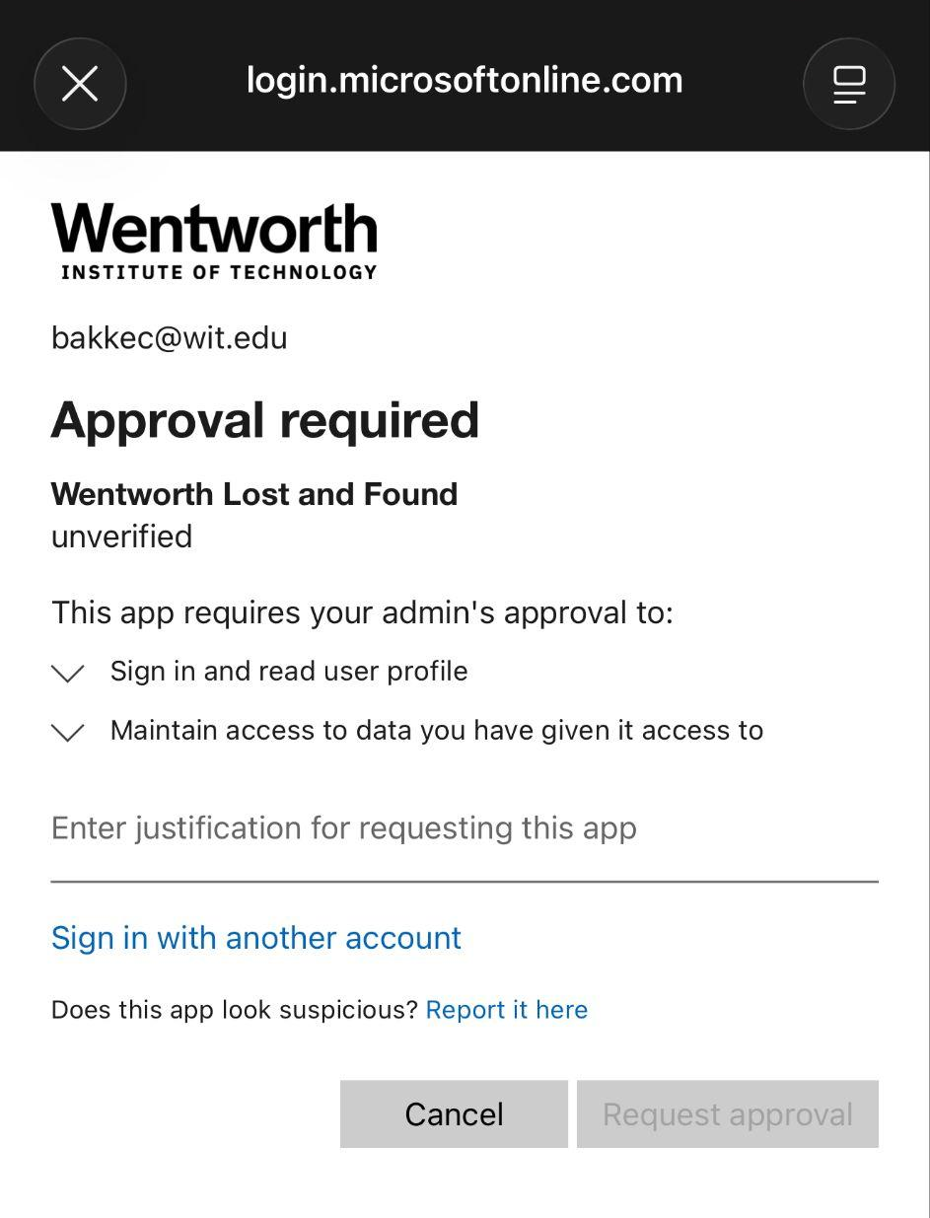
Problems Encountered
Due to Wentworth's organizational security policies, students are restricted from using their Microsoft accounts to sign into unrecognized OAuth applications.
We successfully resolved this by submitting a request to the university's Network Systems and Security (NSS) department, and the application was approved after a brief review period, with the limitation that only users within our COMP 4960 section would be allowed access.
Notes:
Craig

Slide 9
Future Work
Image Recognition and AI Matching
  Using computer vision models and AI, the images will be automatically extracted of its features. This will also aid in the censoring verification process of the description.
  We can have AI give matching confidence scores to potential matches of the found and lost items to help users find their items quicker and more efficiently.
Messaging System
  Incorporating this into the portal would allow users to communicate with each other for meetup times instead of only sending alerts or requiring a third party app to communicate.
User Experience
  Have an extra set of questions asked when a found item is matched in order to provide extra security and proof-of-ownership. For example, what is the wallpaper on your lock screen?
Notes:
Sammy

Slide 10
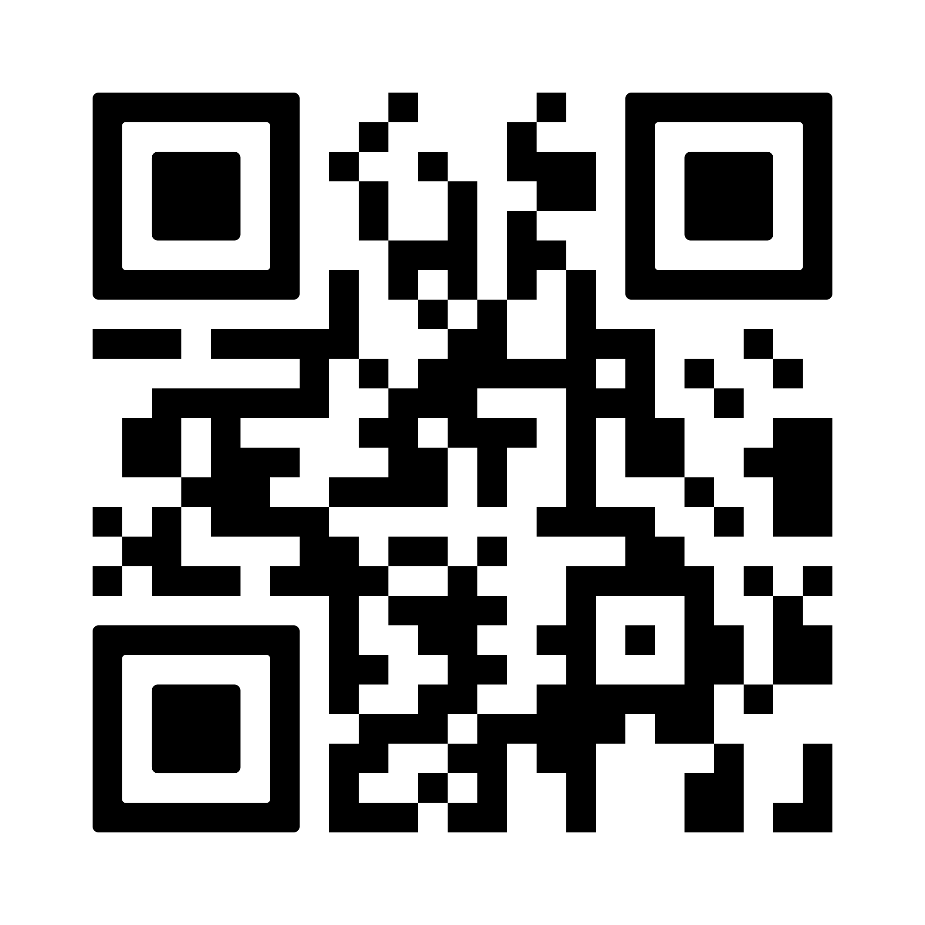
Q&A
Notes:
Try to collect feedback that we can use in the final report

